Slide 1
Determining Support/Opposition using a Recursive Neural Network
Sarah Widder

Slide 2
Motivation
Can a recursive neural network learn to use syntactic structure and word embeddings to classify speech utterances in political debate?
Prevalence of politically oriented text
Bias in media, propaganda
Need to evaluate persuasive documents

Slide 3
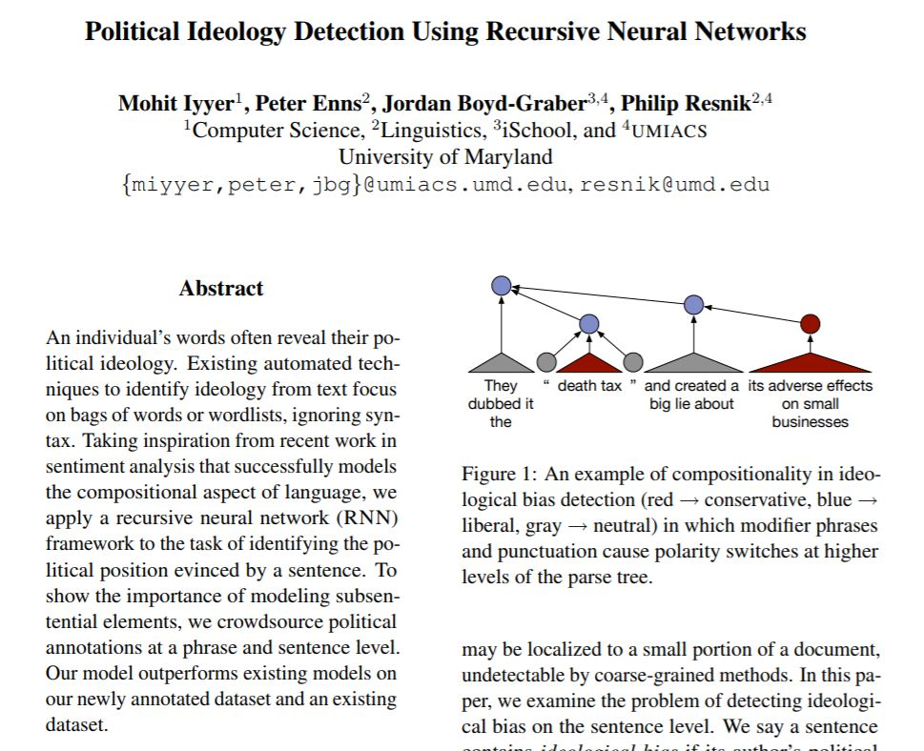
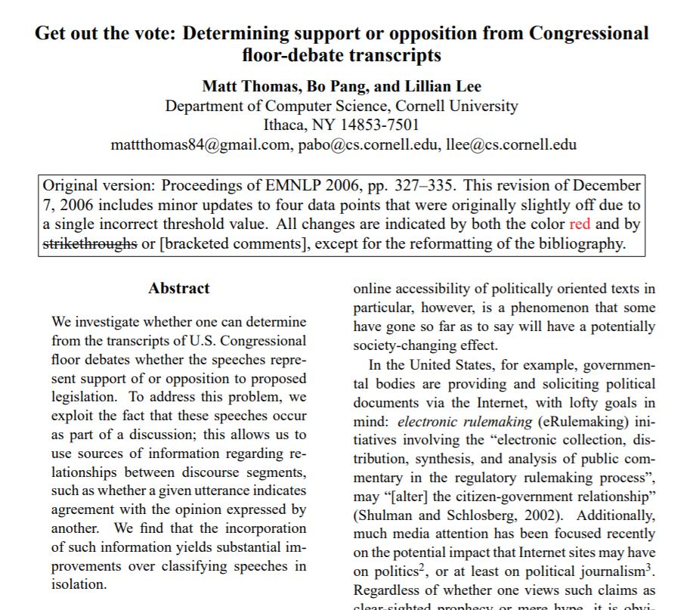
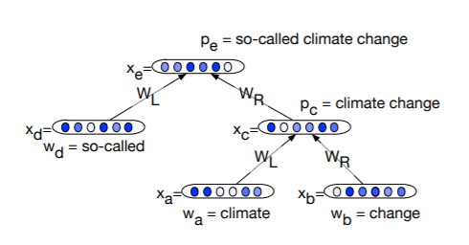
Related Work

Slide 4
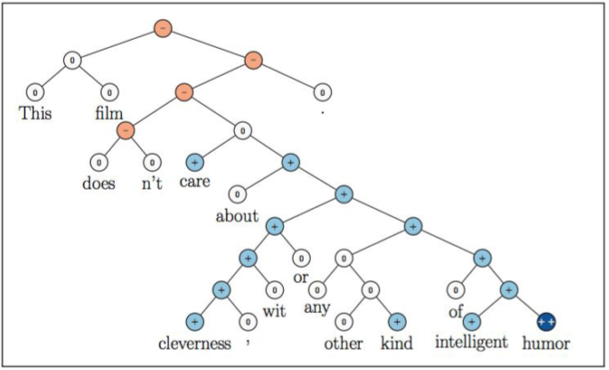
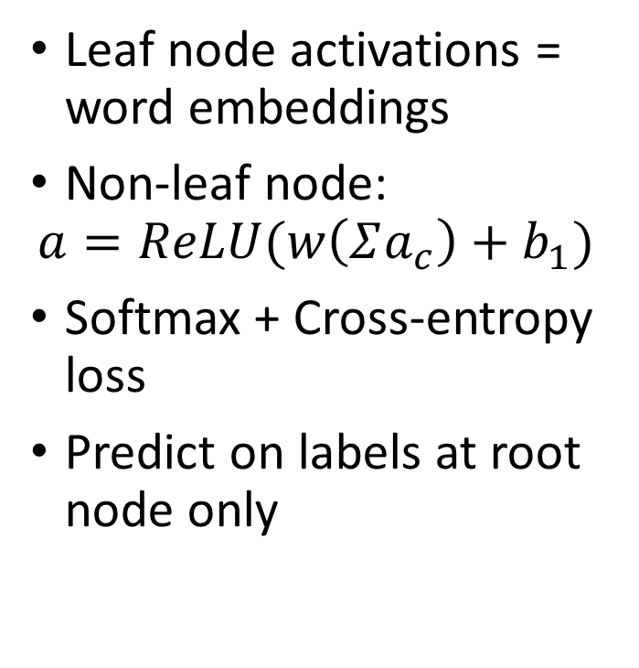
Recursive Neural Network
Leaf node activations = word embeddings
Non-leaf node:
$$a=ReLU(w\left(Σa_{c}\right)+b_{1})$$
Softmax + Cross-entropy loss
Predict on labels at root node only
Socher et al. 2013

Slide 5
Convote Datasets
mr. speaker , i rise in strong support of this balanced rules package .
Transcripts of 2005 U.S. House floor debates
“Ideologically biased” (from Iyyer)
6000 examples
“Extreme” (must include “support” or “oppose”)
1000 examples
Single debate (H.R. 5 rules package)
600 examples
mr. speaker , i rise in opposition to the rules package that we have before us today .

Slide 6
Evaluation
Dataset | Trees | Embedding | Training Accuracy | Test Accuracy
“Ideologically biased” Convote | 3395 “voted yes” 2936 “voted no” (split 700 train, 100 dev, 200 test) | Randomly initialized and updated during training, dimension 35 | 57.0% | 47.0%
“Ideologically biased” Convote | 3395 “voted yes” 2936 “voted no” (split 700 train, 100 dev, 200 test) | Pre-trained GloVe, dimension 50 | 61.0% | 53.6%
“Ideologically biased” Convote | 3395 “voted yes” 2936 “voted no” (split 700 train, 100 dev, 200 test) | Pre-trained GloVe, dimension 100 | 58.4% | 54.0%
“Extreme” Convote (must include “support” or “oppose”) | 499 “voted yes” 489 “voted no” (split 700 train, 88 dev, 200 test) | Pre-trained GloVe, dimension 100 | 91.0% | 55.4%
Single debate from Convote | 217 “voted yes” 370 “voted no” (split 300 train, 50 dev, 100 test) | Pre-trained GloVe, dimension 100 | 77.0% (3 epochs) 99.3% (40 epochs) | 65.0% (3 epochs) 61.0% (40 epochs)

Slide 7
Alternative Methods / Future Work
Overfitting: more balanced distribution of test/training sets
Phrase-level labels
Contents of legislation
Parties of speaker, bill sponsors
Political context
Negation
Difficulty of the task
the resolution we are preparing to consider violates the united states constitution which we were just sworn to uphold and defend .
let me say after having heard from two of my colleagues that i anxiously look forward to working with them in a bipartisan way to try to proceed with the deliberations in consideration of measures of this house .

Slide 8
Thank you!

